Slide 1
Car Market Trends Analysis
Exploratory Data Analysis and Selling Price Prediction using CarDekho Data
Dataset-driven analysis of used-car pricing, demand patterns, depreciation, and key price drivers.
299
Cleaned records
₹4.59 Lakhs lakh
Average selling price
Random Forest
Primary model

Slide 2
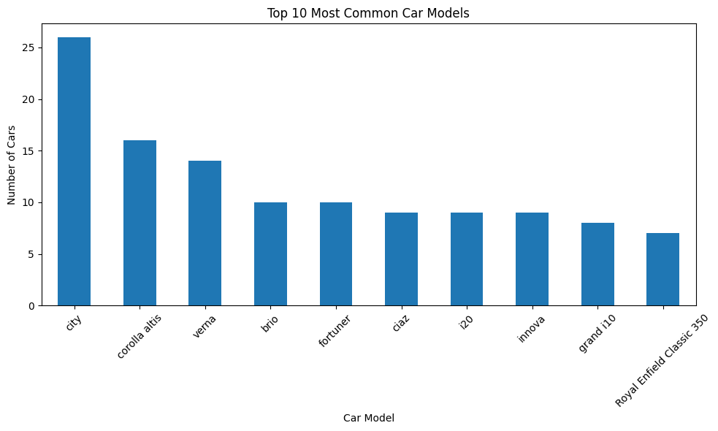
Project Objective & Dataset
Analyze used-car market patterns using CarDekho data.
Understand how fuel type, seller type, transmission, age, and mileage relate to selling price.
Engineer Car_Age and Depreciation_Percentage features.
Build a machine-learning model to predict selling price.

Slide 3
Data Preparation
Original dataset: 301 records and 9 variables.
No missing values were reported in the notebook output.
2 duplicate rows were removed.
Final analysis dataset: 299 records.
Created Car_Age using 2026 − Year.
Calculated depreciation from Present_Price and Selling_Price.
301
Original records
2
Duplicates removed
299
Final records

Slide 4
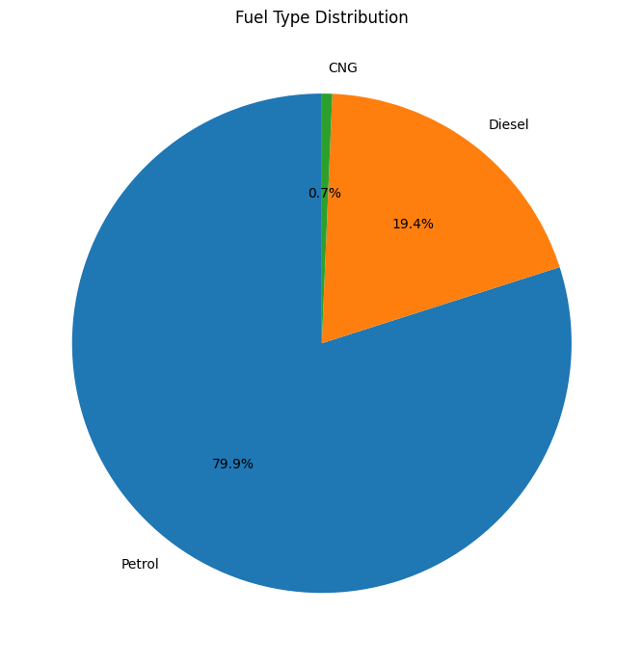
Market Composition: Models & Fuel Types
The analysis identifies the most frequently occurring car models in the dataset.
Most common fuel type: Petrol.
Fuel composition is shown as a dataset distribution, not as a live market-share estimate.

Slide 5
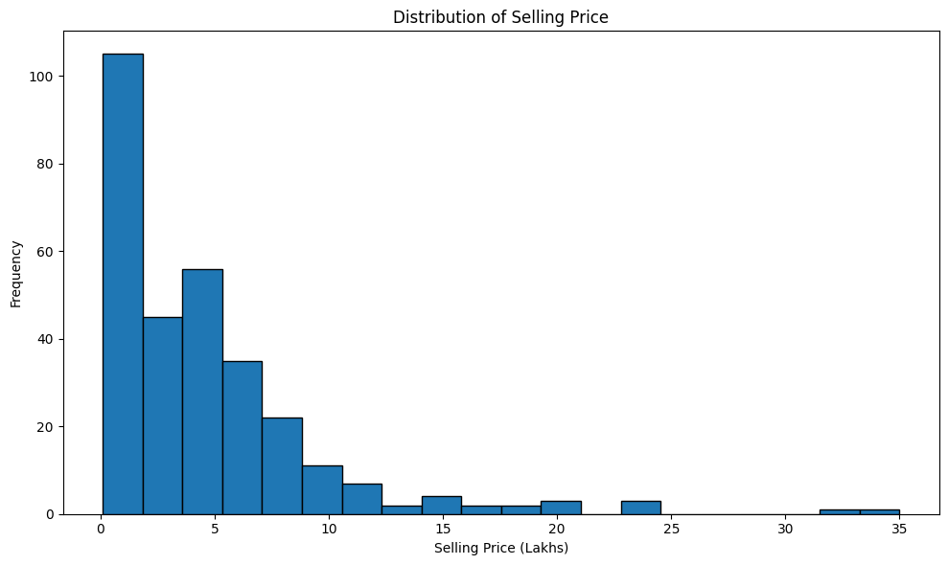
Selling Price Distribution
Average selling price: ₹4.59 Lakhs lakh.
The dataset spans a wide price range, so a small number of high-priced cars can influence the average.
Median price in the original notebook output was ₹3.60 lakh.

Slide 6
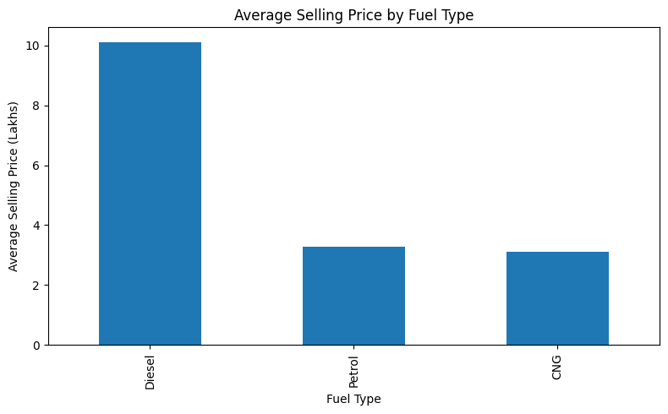
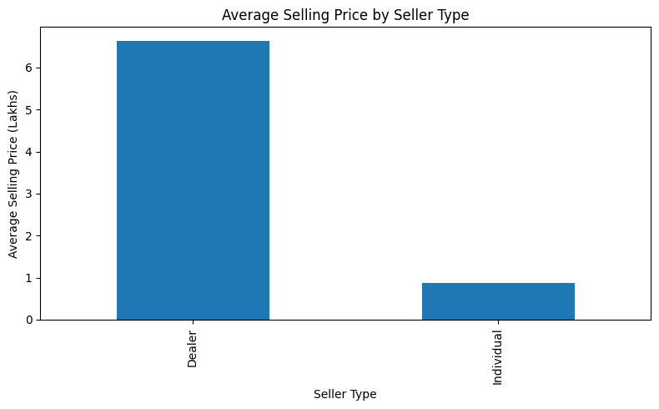
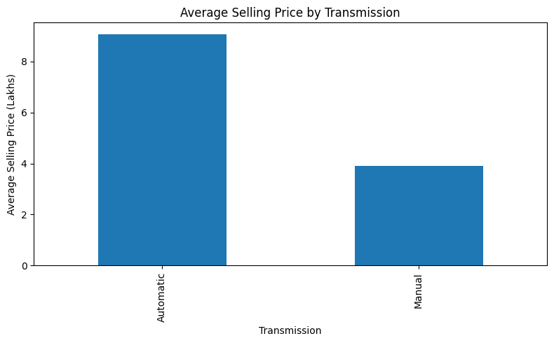
Price Segmentation by Vehicle Attributes
Most common seller type: Dealer.
Most common transmission: Manual.
Average selling prices were compared across fuel type, seller type, and transmission.

Slide 7
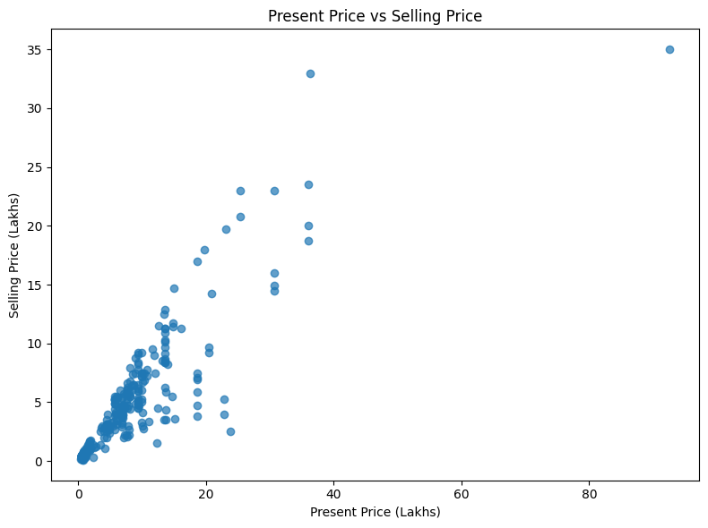
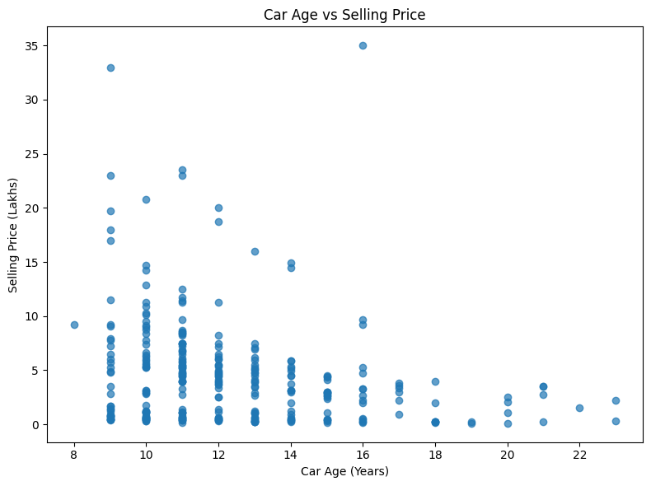
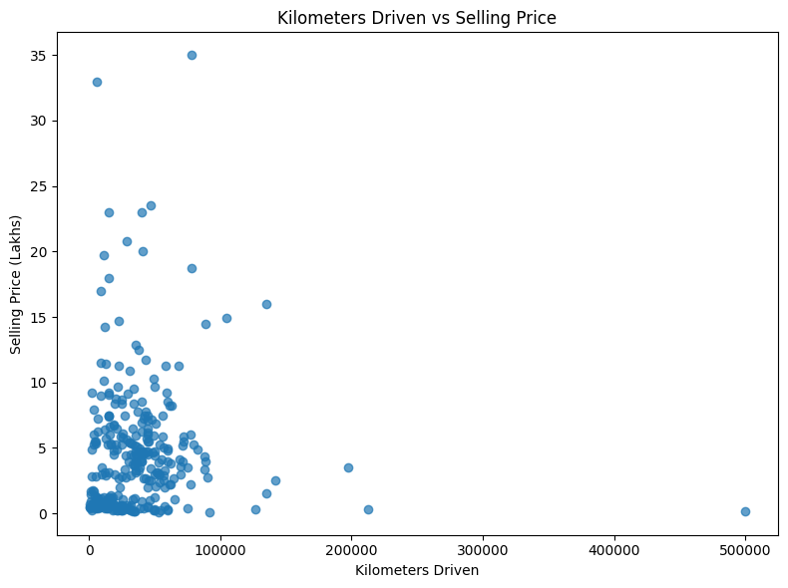
Key Price Drivers
Present price is directly compared with selling price to examine resale value.
Car age is analyzed against selling price to study depreciation over time.
Kilometers driven is analyzed as a usage indicator.
These relationships are associations within the dataset and do not prove causation.

Slide 8
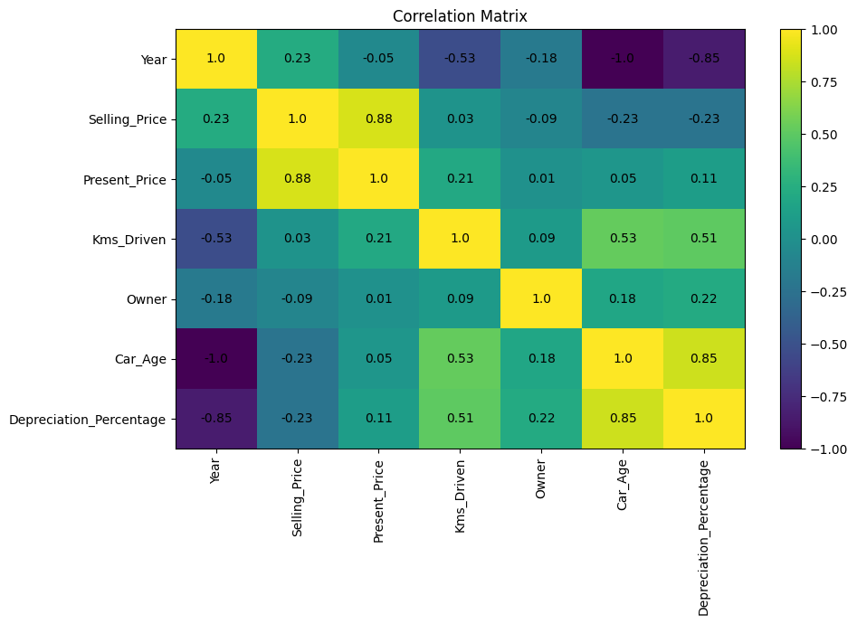
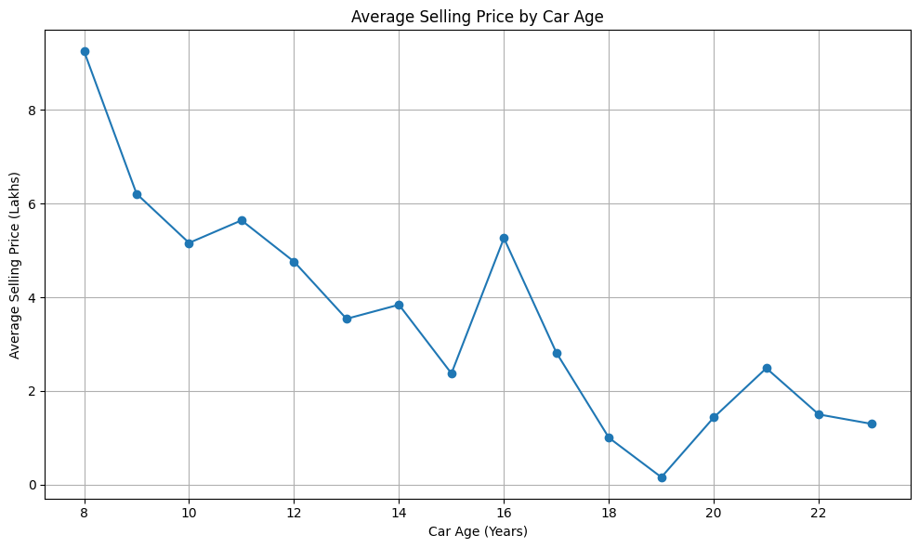
Correlation & Depreciation Analysis
Average depreciation: 36.62 %.
Correlation analysis focuses on numeric relationships among year, prices, mileage, owner count, car age, and depreciation.
Average selling price was also tracked across car-age groups.

Slide 9
Machine Learning: Selling Price Prediction
Model: RandomForestRegressor with 200 estimators.
Categorical variables were label-encoded.
Car_Name was removed because of high uniqueness.
Features were split into 80% training and 20% testing data.
Depreciation_Percentage was excluded from predictors.
1.555
MAE
3.774
RMSE
0.447
R² Score

Slide 10
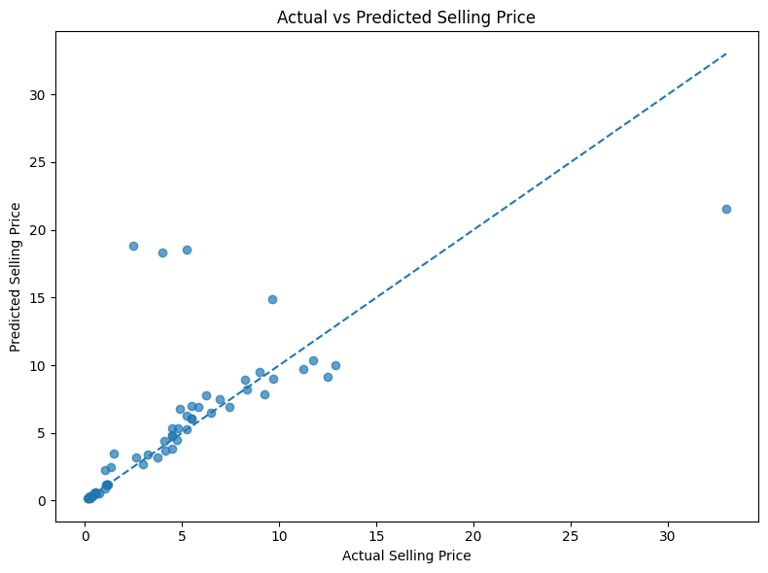
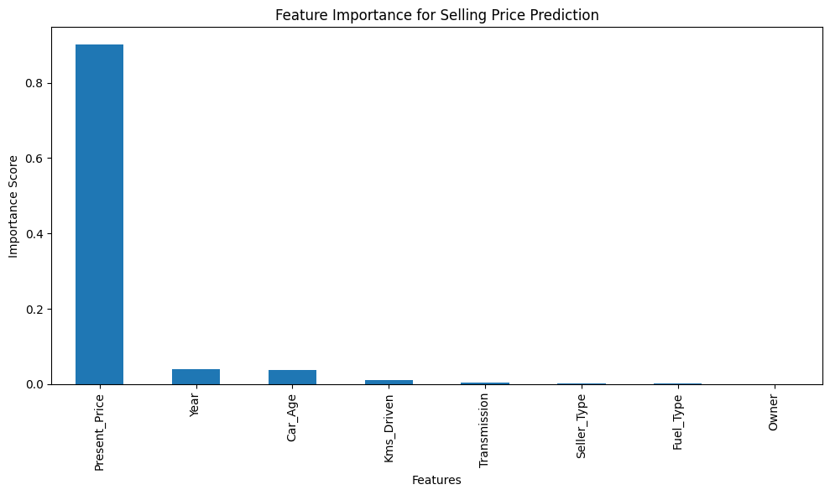
Model Results & Feature Importance
Actual vs predicted values show how closely the model estimates test-set selling prices.
Feature importance ranks the predictors used by the Random Forest model.
Important limitation: this is a small dataset, so performance should not be generalized without validation on new data.

Slide 11
Final Insights
Final dataset analyzed: 299 used-car records.
Average selling price: ₹4.59 Lakhs lakh.
Average car age: 12.38 Years years.
Dominant categories in this dataset: Petrol fuel, Manual transmission, and Dealer sellers.
Resale pricing is multi-factorial: vehicle age, current value, usage, and vehicle characteristics all matter.
The findings describe this dataset and should not be treated as current nationwide market statistics.

Slide 12
Conclusion
Exploratory analysis revealed clear variation in used-car prices across vehicle and market attributes.
Feature engineering made age and depreciation easier to analyze.
A Random Forest model was used to estimate selling prices and identify influential predictors.
Next step: validate the model on newer and larger datasets before production use.

